Slide 1
Scholar Meeting
November 29, 2017
3 PM – 4 PM
SSB 130

Slide 2

Important Info
Continue to check your emails and remember to read them
Feel free to make an appointment with UROC Staff
Keep in contact with your summer mentor, grad students, etc.
Refer to the plans you’ve made this summer to reach grad school and beyond.

Slide 3
Important Dates
December 1: Application Deadlines
December 4 & 6: Study Space
December 5 & 7: De-Stress Event
December 8: End of Semester Social
December 16: Fall Commencement

Slide 4
New UROC Members
We have welcomed new scholars for the 2018 cohorts:
  21 UROC-H Scholars
  4 KURE
  4 JGI

Slide 5
Make the Most of Winter Break
Things you can and should be doing:

Slide 6
Travel Info Review
UROC scholars are encouraged to apply to conferences to present their summer research (UROC-H & MARC are required)
Submit all Travel Requests at least 30 days before the conference
Submit all Reimbursements within 30 days after the conference
Funding through UROC is not guaranteed, but there are other options
  Travel Scholarships through the conference
  ASUCM funding available
  Mentor/PI sponsorship
Notes:
NOTE: the other options… its not this or that. You can get funding from everywhere and BAM you have a free trip!

Slide 7
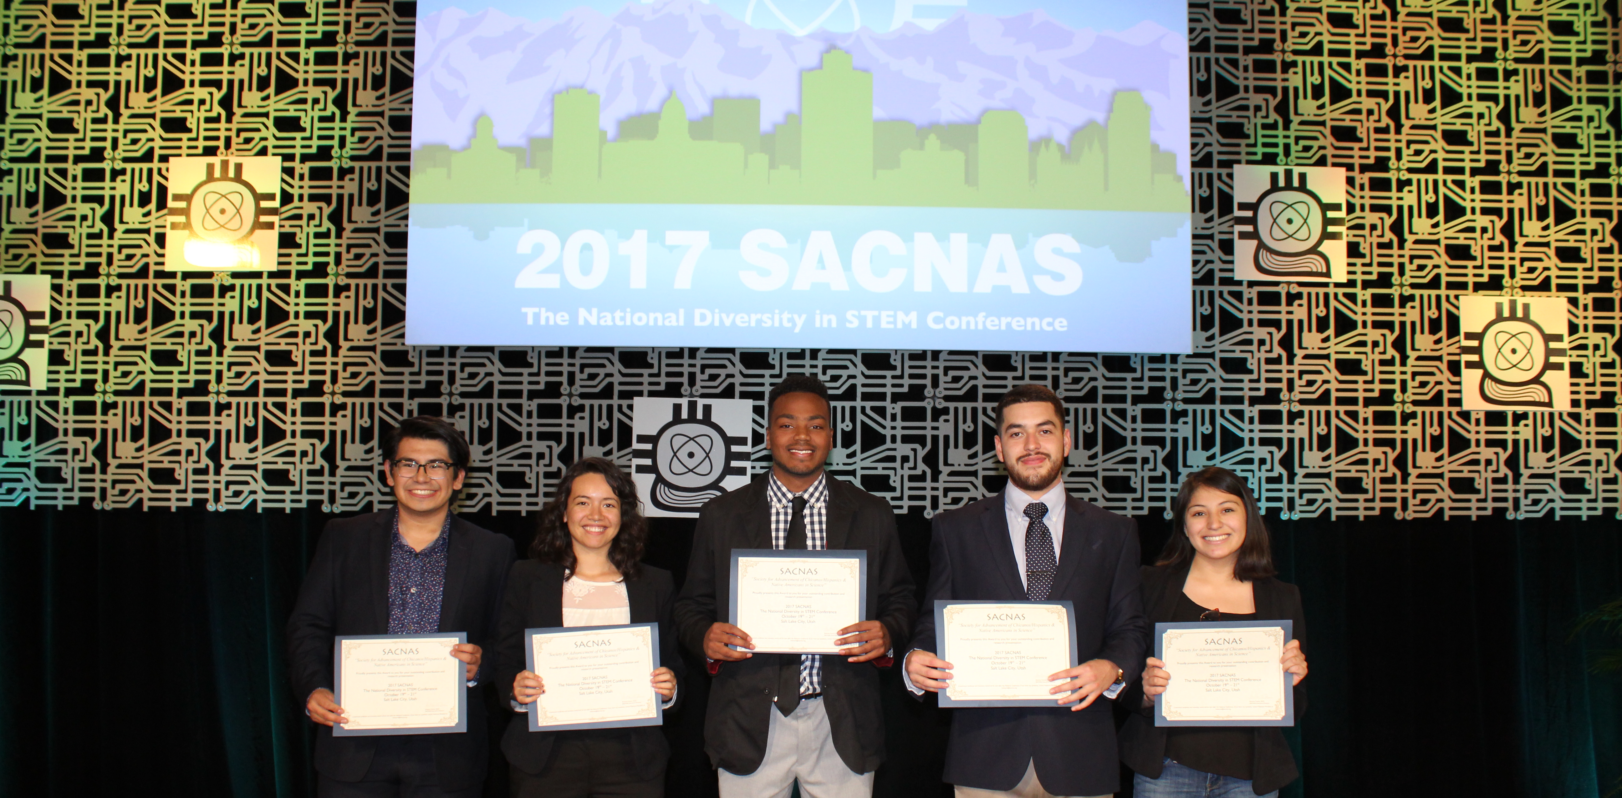
CONGRATS

Slide 8
Recognitions:
UROC would like to know if you have…
  Won an academic award
  Won a research award
  Gone to a conference
  Presented at a conference
  Will be graduating this semester
  Received other recognitions
We’d like to spotlight you on our social media and website!

Slide 9


