Slide 1
Scholar Meeting
November 29, 2017
3 PM – 4 PM
SSB 130

Slide 2

Important Info
Continue to check your emails and remember to read them
Feel free to make an appointment with UROC Staff
Keep in contact with your summer mentor, grad students, etc.
Refer to the plans you’ve made this summer to reach grad school and beyond.

Slide 3
Important Dates
December 1: Application Deadlines for most graduate schools
December 4 – 8: The Final Stretch Series
December 16: Fall Commencement
February 1 – March 15: UROC Applications open
February 2 – 3: CAMP Symposium
March 5 – 9: Research Week @ UC Merced
March 6: Research Week Poster Presentations
March 9 - 10: UC LEADS Symposium

Slide 4
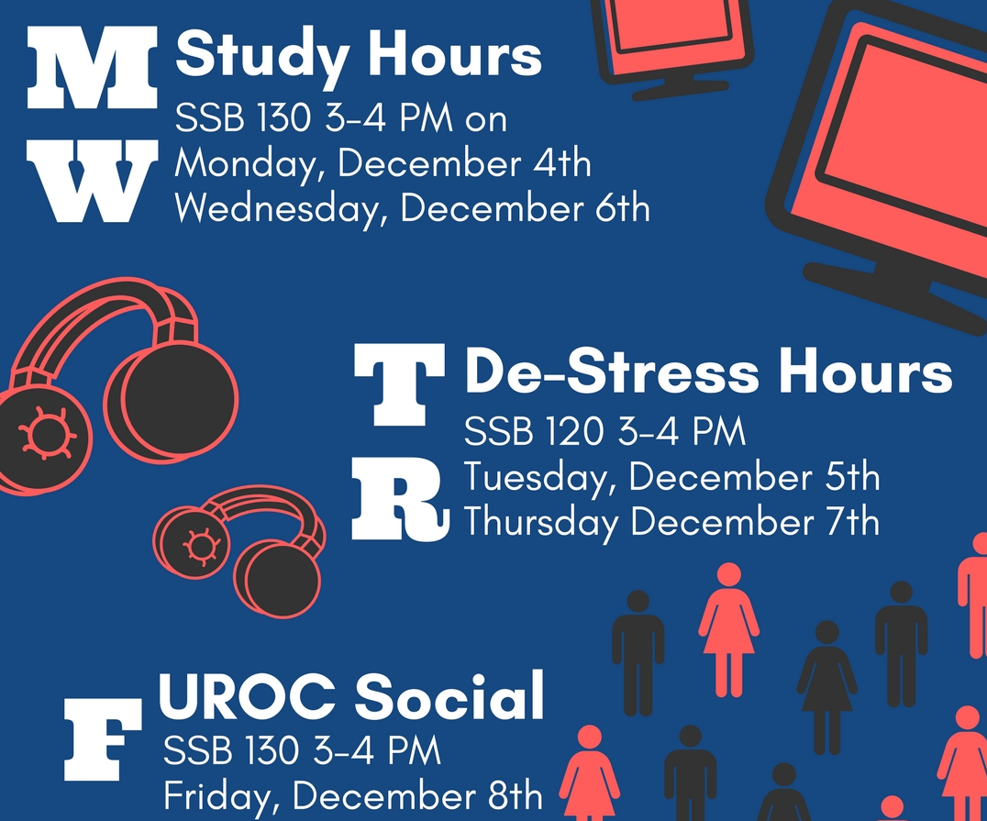
The
Final
Stretch
Series:

Slide 5
New UROC Members
We have welcomed new scholars for the 2018 cohorts:
  21 UROC-H Scholars
  4 KURE
  4 JGI

Slide 6
Make the Most of Winter Break
Things you can and should be doing:
  Have you taken the GRE? Sign up and start studying!
  Plan out your next summer internship/REU
  Time manage Spring 2018 – it’s never too early to plan ahead
  Make a budget for 2018
  Reflect on this year and make goals for 2018
  Update your CV/Resume
  Contact / email mentors

Slide 7
Travel Info Review
UROC scholars are encouraged to apply to conferences to present their summer research (UROC-H & MARC are required)
Submit all Travel Requests at least 30 days before the conference
Submit all Reimbursements within 15 days after the conference
Funding through UROC is not guaranteed, but there are other options
  Travel Scholarships through the conference
  ASUCM funding available
  Mentor/PI sponsorship
Notes:
NOTE: the other options… its not this or that. You can get funding from everywhere and BAM you have a free trip!

Slide 8
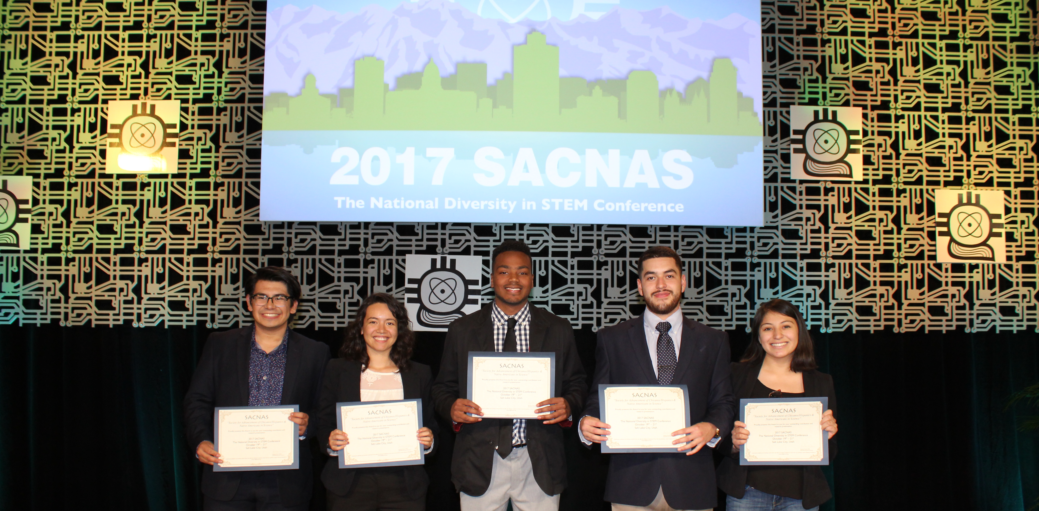
CONGRATS

Slide 9
Recognitions:
UROC would like to know if you have…
  Won an academic award
  Won a research award
  Gone to a conference
  Presented at a conference
  Will be graduating this semester
  Received other recognitions
We’d like to spotlight you on our social media and website!

Slide 10


